Slide 1
DEBUGGING USING GDB
OPTIMIZATION OF CODE
TREES
BHAVANA
DAY 20
30/04/2024

Slide 2
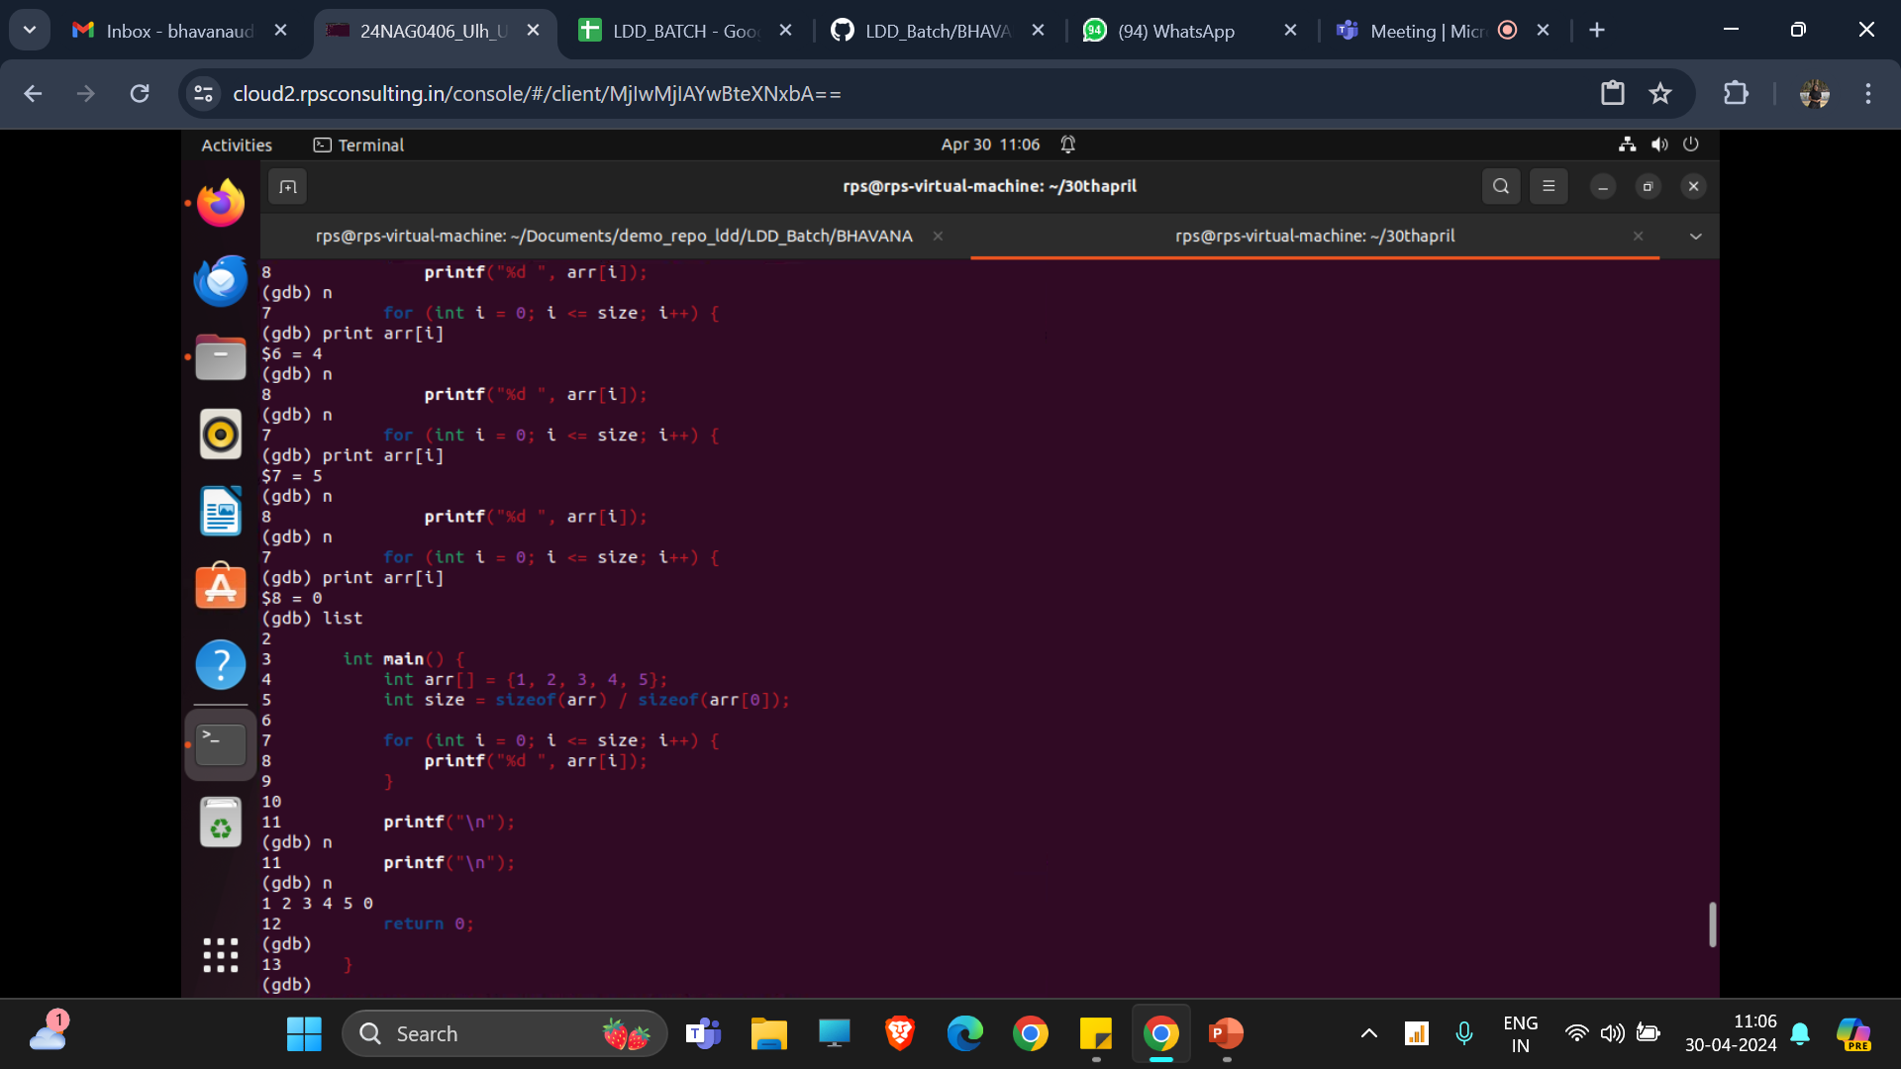
INITIAL OUTPUT AFTER DEBUGGING:
PROGRAM:
#include <stdio.h>
int main()
{
int arr[] = {1, 2, 3, 4, 5};
int size = sizeof(arr) / sizeof(arr[0]);
for (int i = 0; i <= size; i++)
{
printf("%d ", arr[i]);
}
printf("\n");
return 0;
}

Slide 3
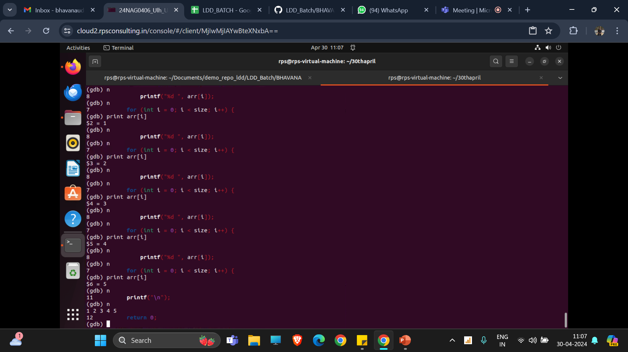
AFTER MODIFYING THE PROGRAM AND DEBUGGING:(i < size)

Slide 4
OPTIMIZATION OF CODES:
OPT2: #include <stdio.h> #include <time.h> int main() { // Start the clock clock_t start = clock(); // Unrolled Loop (improves performance for small Loop iterations) int sum = 0; int n = 1000; for (int i = 0; i < n; i += 2) { sum += i; if (i + 1 < n) { sum += i + 1; } } // Stop the clock clock_t end = clock(); // Calculate the elapsed time double time_taken = ((double)(end - start)) / CLOCKS_PER_SEC; printf("Sum: %d\n", sum); printf("Time taken for the unrolled loop: %f seconds\n", time_taken); return 0; }
OPT 1: #include <stdio.h> #include <time.h> int main() { // Start the clock clock_t start = clock(); // Original Loop (Less efficient) int sum = 0; int n = 1000; for (int i = 0; i < n; i++) { sum += i; } // Stop the clock clock_t end = clock(); // Calculate the elapsed time double time_taken = ((double)(end - start)) / CLOCKS_PER_SEC; printf("Sum: %d\n", sum); printf("Time taken for the original loop: %f seconds\n", time_taken); return 0; }

Slide 5
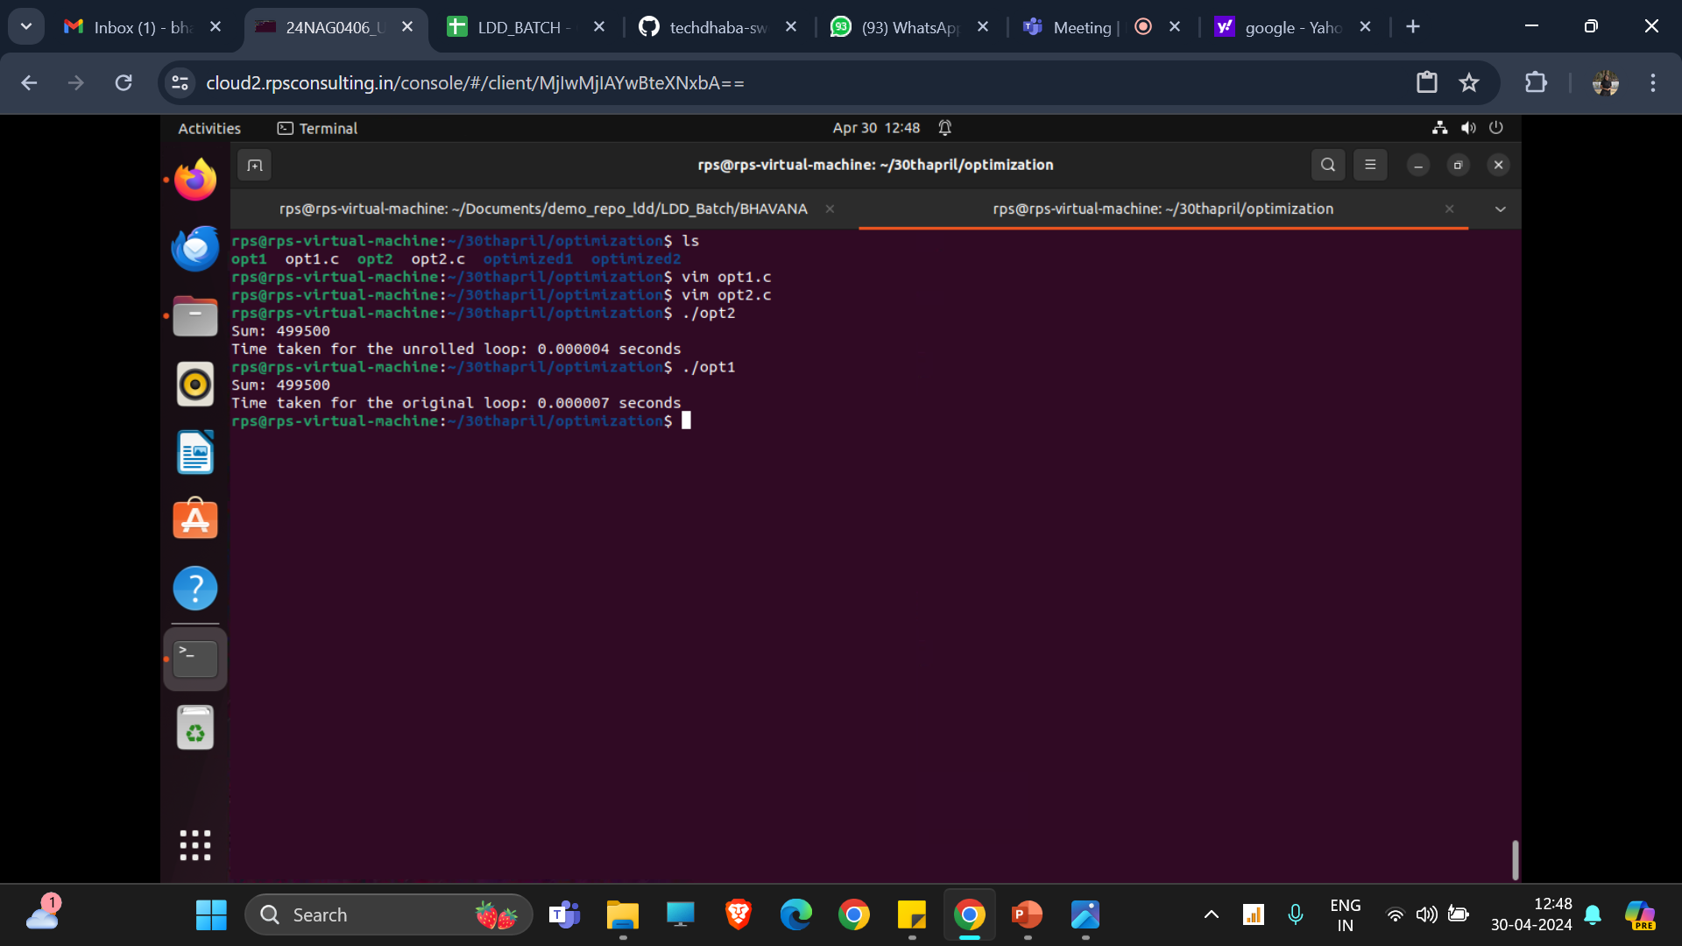
DIFFERENCE IN TIME:

Slide 6
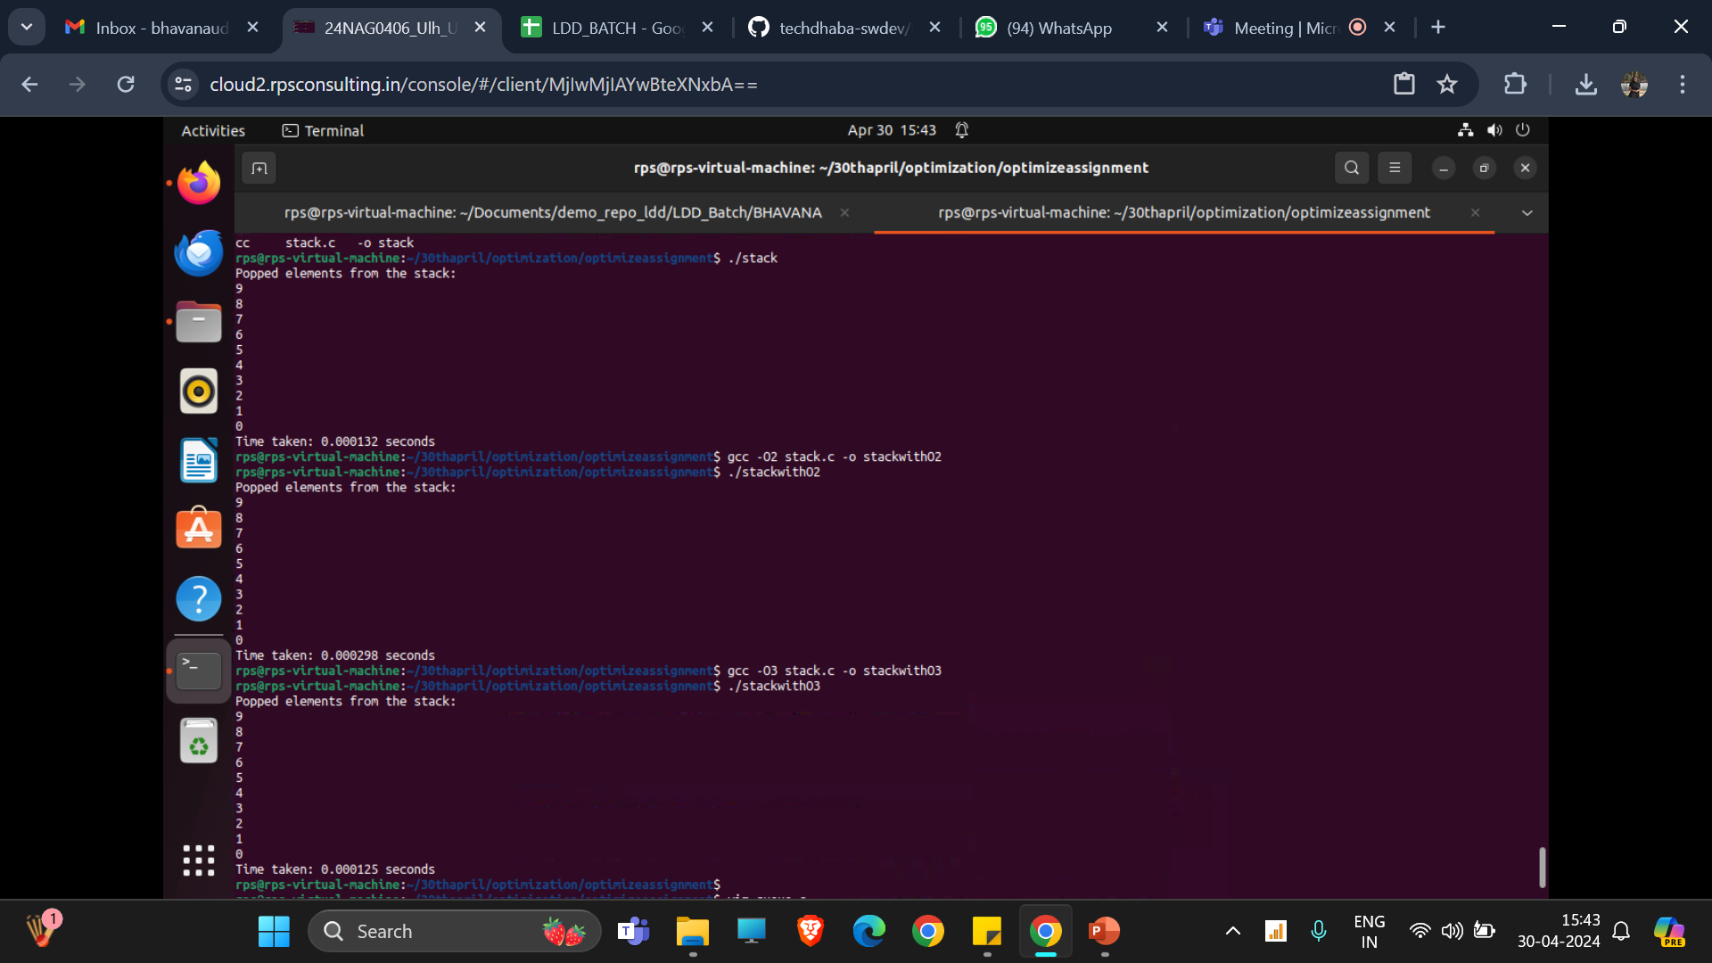
OPTIMIZING CODE WITH COMMANDS:
gcc -O2 unroll.c -o unroll COMMAND
gcc –O3 unroll.c -o unroll COMMAND:
EXAMPLE

Slide 7
What is a tree?
Trees are structures used to represent hierarchical relationship
Each tree consists of nodes and edges
Each node represents an object
Each edge represents the relationship between two nodes.
node
edge

Slide 8
Terminology I
For any two nodes u and v, if there is an edge pointing from u to v, u is called the parent of v while v is called the child of u. Such edge is denoted as (u, v).
In a tree, there is exactly one node without parent, which is called the root. The nodes without children are called leaves.
root
u
u: parent of v
v: child of u
v
leaves

Slide 9
Terminology II
If two nodes have the same parent, they are siblings.
A node u is an ancestor of v if u is parent of v or parent of parent of v or …
A node v is a descendent of u if v is child of v or child of child of v or …
u
v and w are siblings
u and v are ancestors of x
v and x are descendents of u
v
w
x

Slide 10
Terminology III
Level of a node n: number of nodes on the path from root to node n
Height of a tree: maximum level among all of its node
Level 1
Level 2
height=4
n
Level 3
Level 4

Slide 11
In a tree, the nodes without children are called leaves. Otherwise, they are called internal nodes
A subtree is any node together with all its descendants.
T
A subtree of T
v
v

Slide 12
Binary Tree
Binary Tree: Tree in which every node has at most 2 children
Left child of u: the child on the left of u
Right child of u: the child on the right of u
x: left child of u
y: right child of u
w: right child of v
z: left child of w
u
v
x
y
w
z

Slide 13
Full binary tree
If T is empty, T is a full binary tree of height 0.
If T is not empty and of height h >0, T is a full binary tree if both subtrees of the root of T are full binary trees of height h-1.
Full binary tree
of height 3

Slide 14
Ways to traverse a tree
There are three main ways to traverse a tree:
Pre-order:
(1) visit node, (2) recursively visit left subtree, (3) recursively visit right subtree
In-order:
(1) recursively visit left subtree, (2) visit node, (3) recursively right subtree
Post-order:
(1) recursively visit left subtree, (2) recursively visit right subtree, (3) visit node
Level-order:
Traverse the nodes level by level
In different situations, we use different traversal algorithm.

Slide 15


